Slide 1
Information Design
Design for clear everyday communication

Slide 2

Introduction
Design shapes how people receive and interpret information in daily contexts.
Effective layout guides attention and improves comprehension through visual hierarchy and clear structure.

Slide 3

01
Design Principles

Slide 4

Visual hierarchy
Use size, color, and positioning to guide attention from most to least important.
Group related elements and create contrast to make the reading path obvious, improving quick scanning and decision-making.

Slide 5
Typography & readability
Choose legible typefaces and appropriate sizes for the medium; limit font families for clarity.
Manage line length, spacing, and contrast to enhance readability and sustain engagement.

Slide 6
Spacing & alignment
Proper spacing and consistent alignment create order and reduce cognitive load, making content easier to scan and understand.
Use margins, padding, and grids to establish rhythm; align elements to a common axis to reinforce relationships and improve visual coherence.

Slide 7

01
Application & Context

Slide 8
Scanning behavior
Readers typically scan for cues rather than read word-for-word, so emphasize key points with hierarchy and contrast.
Design for quick recognition: headings, bullets, and highlighted phrases guide attention and enable faster comprehension.

Slide 9
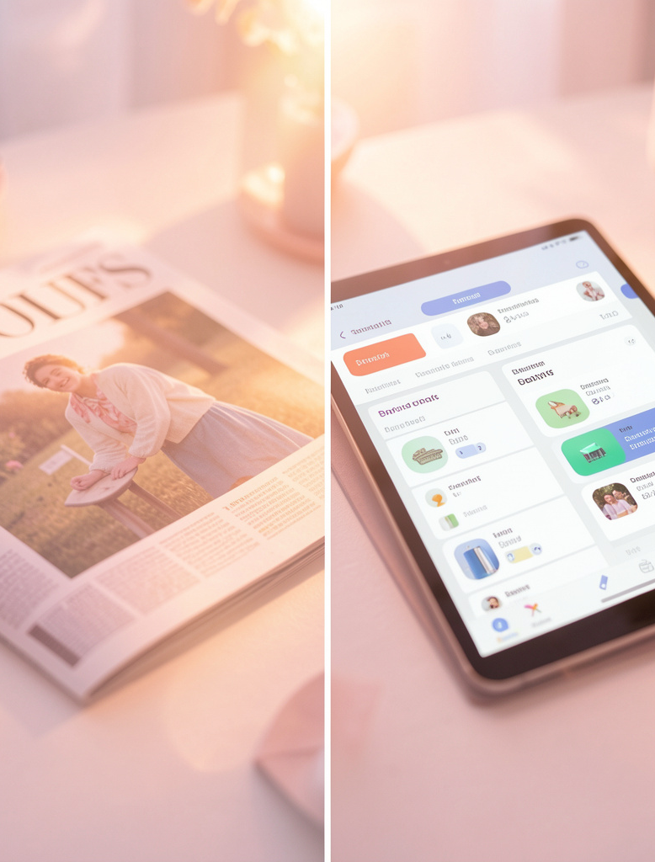
Print vs digital
Core principles apply across media, but execution differs: print favors fixed layouts and fine typography; digital requires responsive grids and interactive cues.
Adjust scale, spacing, and contrast for screens to maintain readability and user control.

Slide 10
Images & icons
Use images and icons to support meaning, not decorate; they should clarify concepts, provide context, or anchor memory.
Maintain consistent style and ensure visual elements align with hierarchy and spacing to avoid distraction.

Slide 11
Conclusions
Design is a communication tool that shapes understanding; effective use of hierarchy, typography, spacing, and imagery improves clarity and engagement.
Prioritize layout that supports scanning and adapt principles to medium to deliver messages that are both accessible and persuasive.

Slide 12
THANKS!
Does anyone have any questions?
addyouremail@freepik.com
+91 620 421 838
yourcompany.com
Please keep this slide for attribution

